Slide 1

Logistics and Shipping Hub
Phase 1 (Group 22)
CSP-584
Enterprise Web Applications
Laxmi Naarayanan Thirumalai - A20519912
Shivam Gupta- A20520254
Rohit Kumar - A20501314

Slide 2
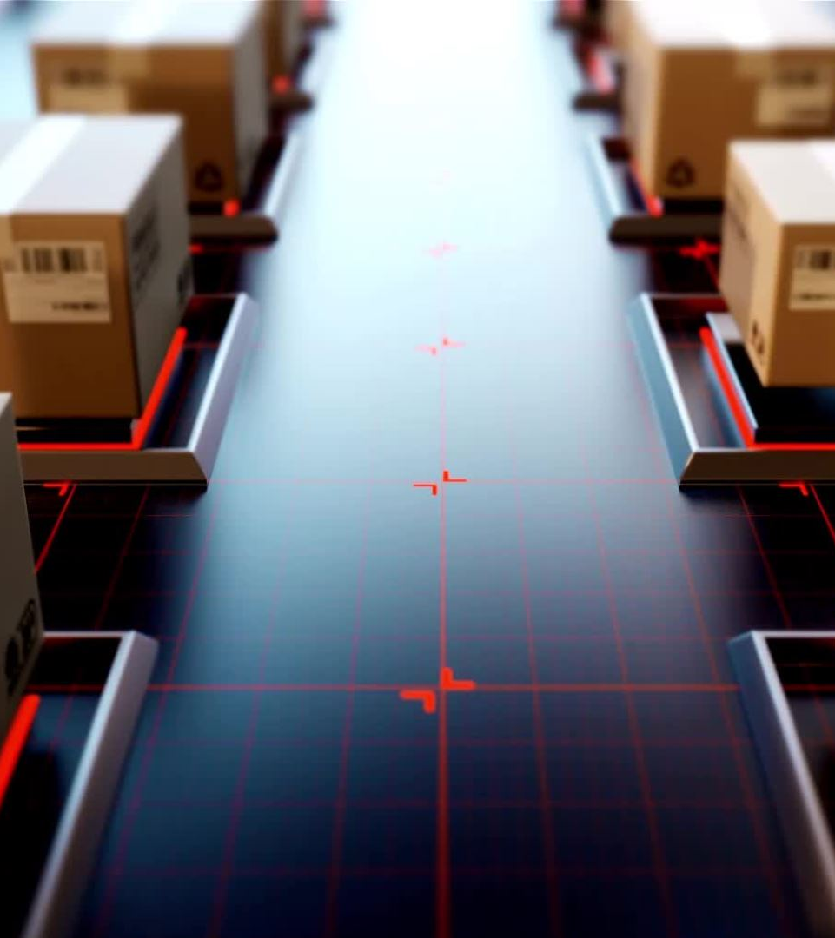
Introduction
A Logistics and Shipping Hub, also known as a transportation hub, is a centralized facility that plays a crucial role in the management, coordination, and optimization of the movement of goods, products, and materials.

Slide 3

Objective of Logistic and Shipping Hub
E-commerce Shipping Integration
Inventory Management for Small Business
Send or Receive a Local Package
Third-Party Logistics (3PL) Services
Door-step delivery

Slide 4
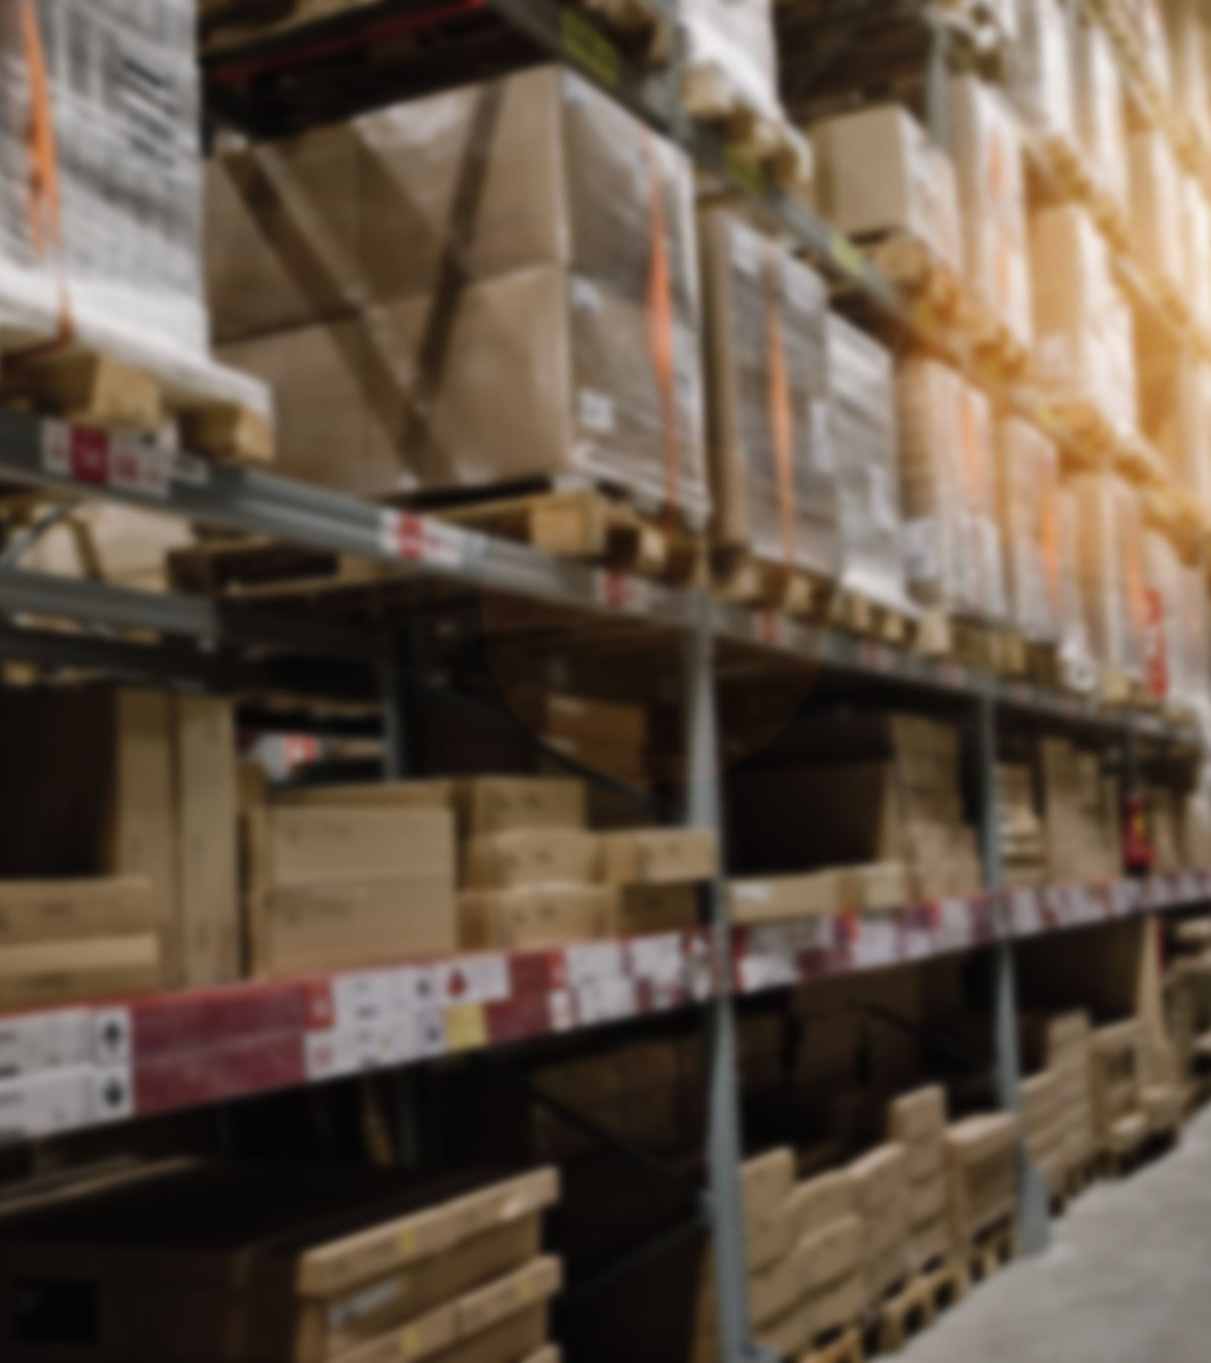
User Specifications
Types of Users -
Individual
Business
Admin
Warehouse Agent
Delivery Agent

Slide 5
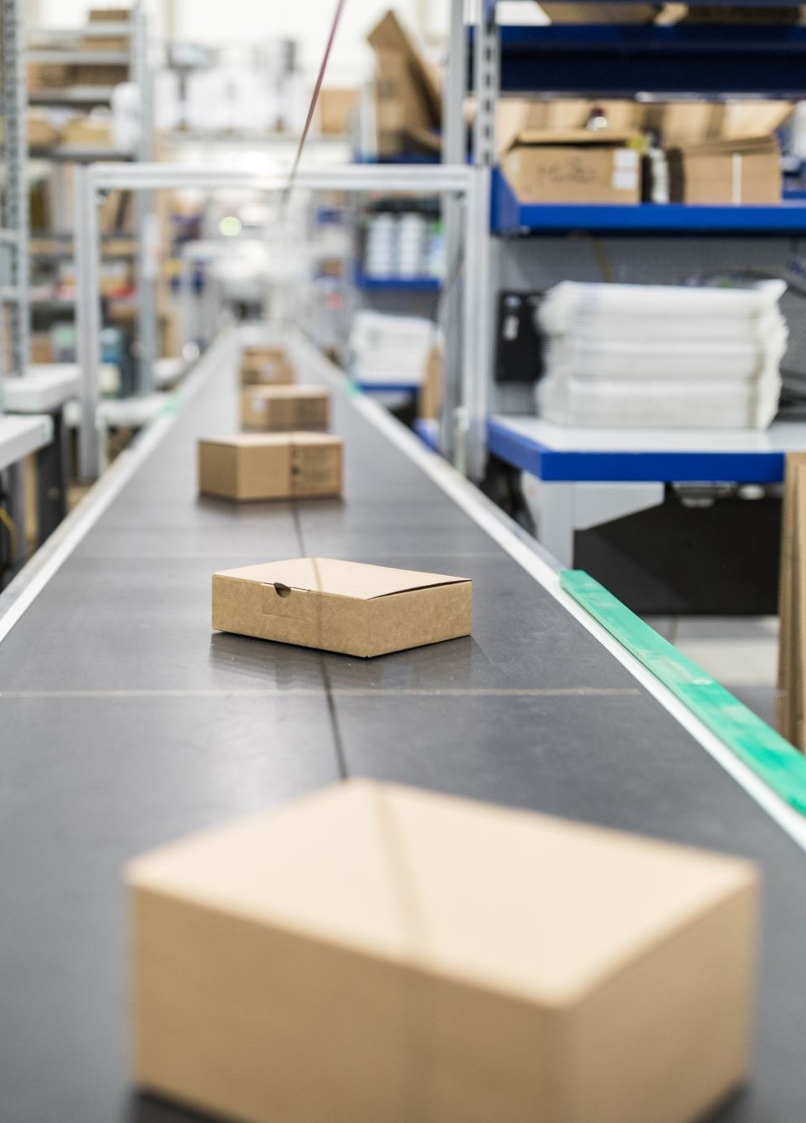
User Functionalities
Individuals/ Business users:
-> Registration and Login
-> Create order: Schedule delivery and pickup timing and locations
-> Send or receive package within same town
Admin
-> Add new store and warehouse locations
-> User and Order Management
Warehouse Agent
-> Store and dispatch orders
-> Deliver in-store pickups
Delivery Agents
-> Notifies/updates delivery and pickup status to customers

Slide 6

Technology Stack
MongoDB
Express
Angular
Node
MySQL

Slide 7
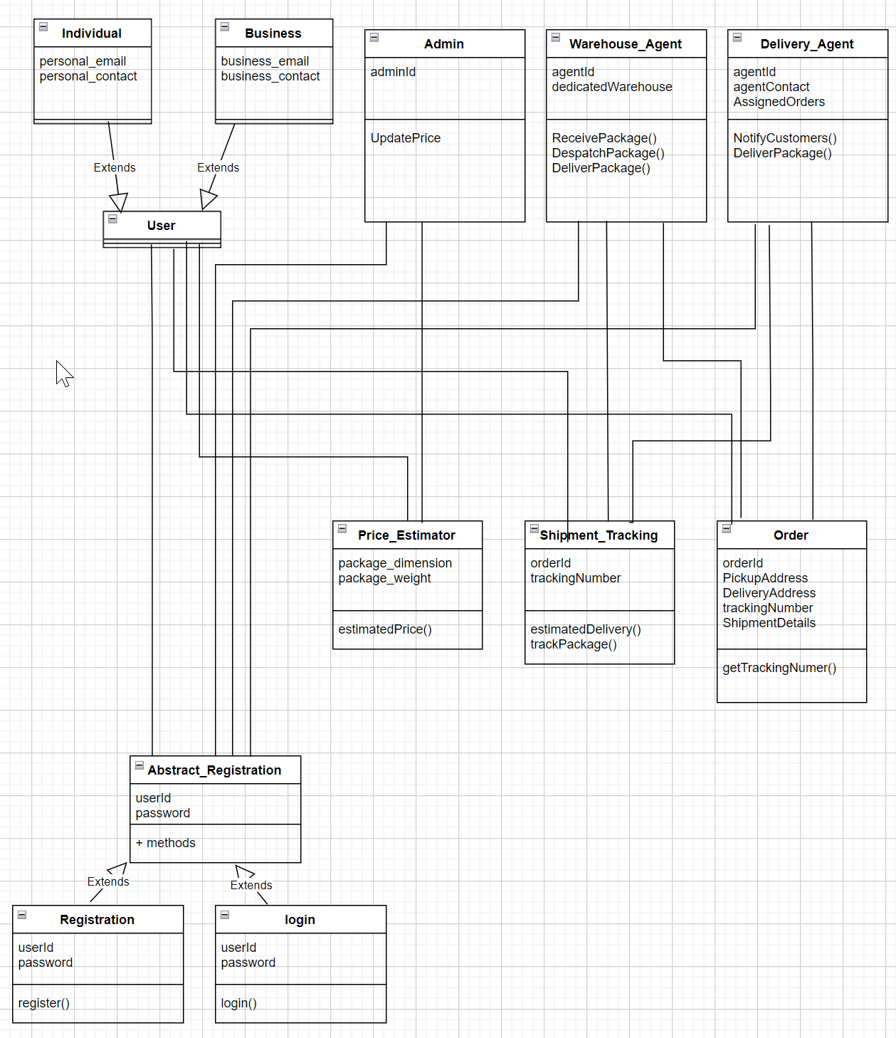
ER Diagram

Slide 8
Thank you!

